Slide 1
IVOD AI System
21st June Presentation
Prepared by Wayne Teng
Notes:
Prepare a slide (not more than 5 slides) explaining data engineering and ML side of the story. I will incorporate these slides into my song’n’dance [Wayne]

Slide 2
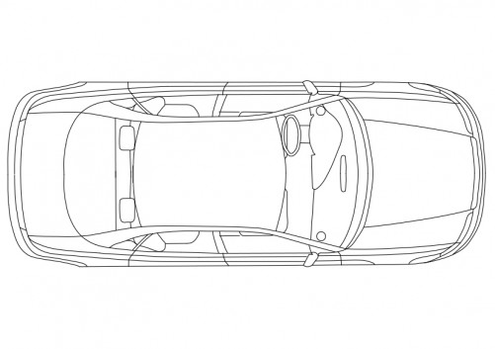
Introduction to IVOD AI System
The IVOD AI system comprises of multiple binary-classification deep-learning models. (FrontPassenger(FP)/LeftBack(LB) Predictors etc)
The models uses uRAD v2.0 radars as input data and attempt to classify whether each of the seats in the vehicle car is occupied.
Data are segregated, preprocessed and then used for training (automated parameters tuning) on a ResNet34 model (A type of deeplearning AI model)
Subsequently the models are evaluated on another segregated devtest dataset for benchmark performance
LB
FP
RB
D

Slide 3
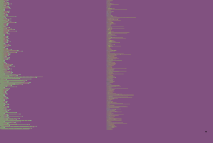
Model development
Model Development
Training Data (60% of entire dataset)
Achieves by data engineering
Preprocessing pipeline for DeepLearning
Predictors evaluated based on Test data subset
Entire manually annotated Dataset collected (Raw data)
Validation Data (20% of entire dataset)
Training
Test Data (20% of entire dataset)
Preprocessing for DeepLearning calculations, for each instance 1. Tensorize into a Torch Tensor object
2. Concatenate radar1 and radar2 into one torch tensor
3. Normalize data
4. Standardize data
Data Engineering
Entire manually annotated Dataset collected
Quantifies each data instance as a 10second recording of radar outputs
Shuffle dataset and split dataset into 3 balanced subset (Train/Validation/Test)

Slide 4
Model development
Model Development
Training Data (60% of entire dataset)
Preprocessing pipeline for DeepLearning
Predictors evaluated based on Test data subset
Entire manually annotated Dataset collected (Raw data)
Validation Data (20% of entire dataset)
Training
Test Data (20% of entire dataset)
Preprocessed Test data
Training Flow
Evaluate model performance based on Test dataset
Continue loop for pre-defined epochs count
Save the model checkpoint that achieves the greatest validation performance
Preprocessed training data
Evaluate models based on validation performance
Perform models’ parameter updates
Preprocessed validation data
Predictor with a benchmark score

Slide 5
High level idea of the development of model
Model Development
Training Data (60% of entire dataset)
Preprocessing pipeline for DeepLearning
Predictors evaluated based on Test data subset
Entire manually annotated Dataset collected (Raw data)
Training
Validation Data (20% of entire dataset)
Test Data (20% of entire dataset)
Data Lineage Documentation
Inference Engine using developed Model
Predictions FP:1or0
LB:1or0
Replicated Preprocessing Pipeline for DeepLearning
Live serving data to be inferred during deployment
Predictors

Slide 6
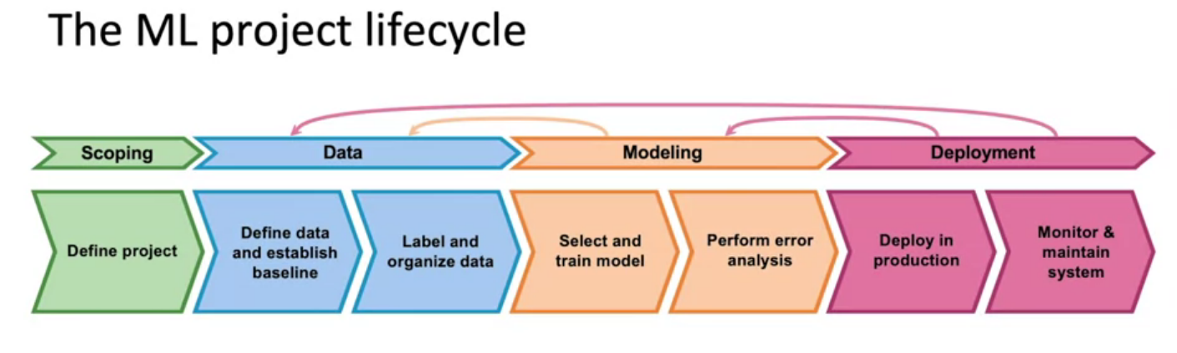
Deployment plan
uRAD v2.0 radars as input data
ResNet34 deeplearning AI
model
ML Project Life cycle is continuously iterative
First few attempt on live deployment may not achieves optimal performance
A few round of iterations may be needed, from data/modeling level

